Slide 1
‘Busy’ Record, Put-callback Lab
Kay Kasemir
Feb. 2022

Slide 2
Adding Busy Record to IOC
Busy record is not included in EPICS base.
Add to IOC via SomeApp/src/Makefile Some_DBD += busySupport.dbd Some_LIBS += busy
See /ics/examples/21_busyApp

Slide 3
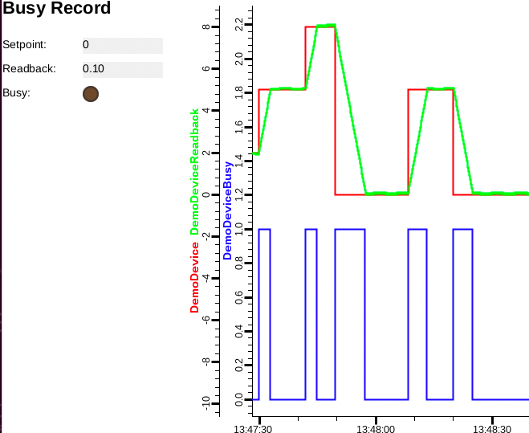
Example Database
Read /ics/examples/21_busyApp/Db/busy_demo.db
cd /ics/examples/iocBoot/ioc_busy; ./st.cmd
Monitor DemoDevice and DemoDeviceReadback, for example using the display in /ics/examples/21_busyApp/opi
Try the following, explain what’s happening
caput DemoDevice 2
caput DemoDevice 5
caput –c –w 20 DemoDevice 2
caput –c –w 20 DemoDevice 5
caput –c DemoDevice 2

